Slide 1

Makerfabs
Agile Manufacturing Service Guide
www.makerfabs.com

Slide 2
Makerfabs Overview
Part 01

Slide 3
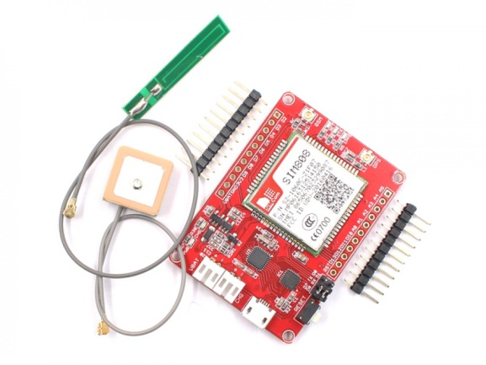
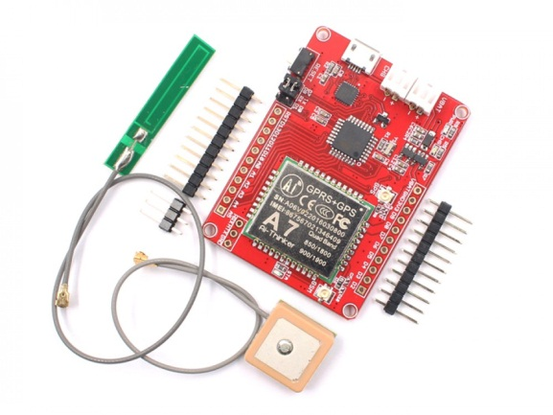

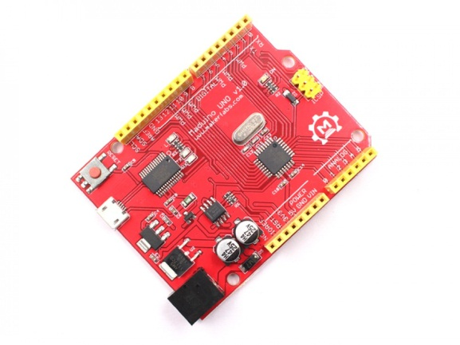
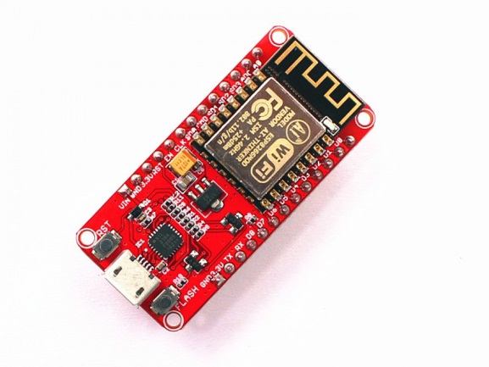
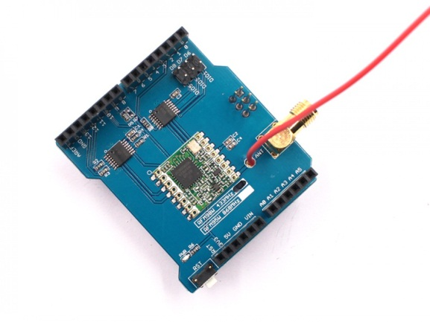
We offer:
More than 30 designs, for Open Hardware/IOT
… …
SIM808 GPS Tracker
A7 GPS Tracker
IOT Starter Kits
Open hardware Arduino
Node MCU ESP12 Wifi Module
More than 20 Kinds of Arduino Shields
Notes:
图文配置

Slide 4
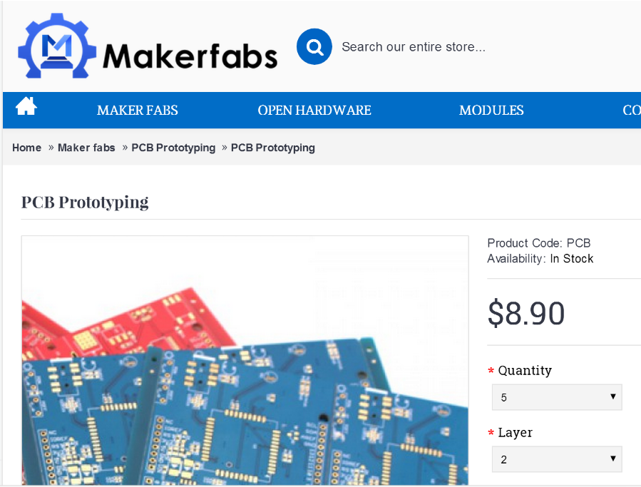
We offer:
Express PCB
Prototype
Maker Education Kits
Open Source Hardware Modules
Theme Based Kits
Technical Solutions
Produce
PCB Prototyping Service
Hardware Development Kit
Agile and Open Manufacturing Service
Distributed Portal
Promote
More than 100 distributor
Ecommerce
Global Distribution
https://www.makerfabs.com/index.php?route=product/product&path=93_106&product_id=138
www.makerfabs.com
Notes:
图文配置

Slide 5
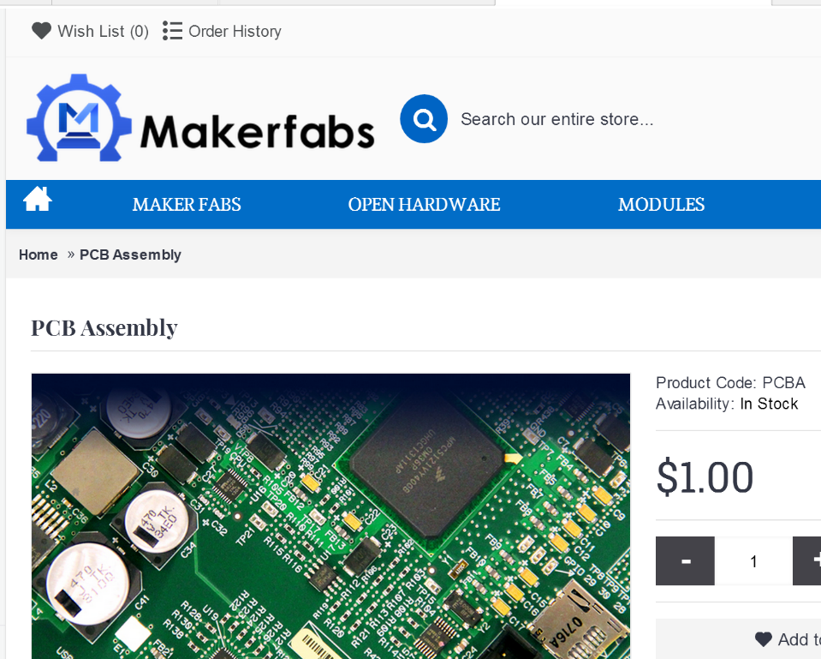
We offer:
Turn Key PCBA Service
One stop service
Making prototyping of any electronics product easy and flexible, from the 1 pcs prototyping to mass Production.
1-1000 pcs
Unleash the flexibility from decentralized and small batch manufacturing.
14~21 days
Average lead time
https://www.makerfabs.com/PCB-Assembly.html
www.makerfabs.com

Slide 6
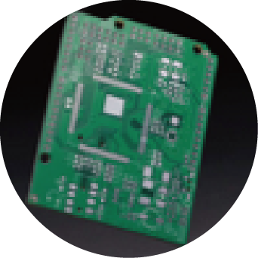
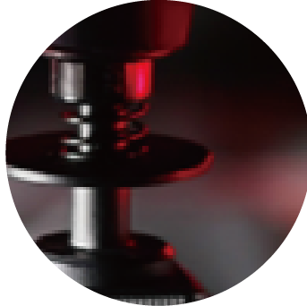
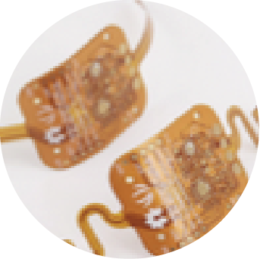
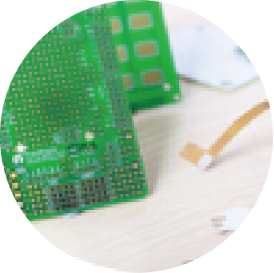
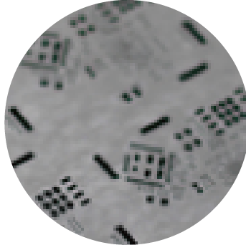
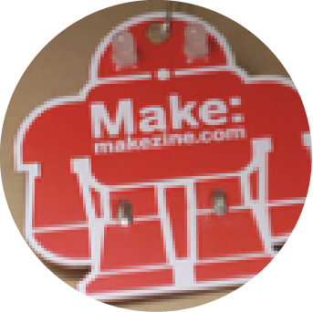
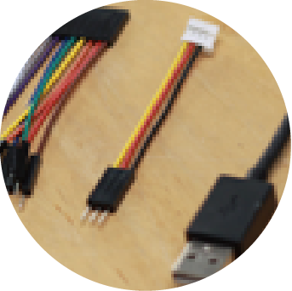
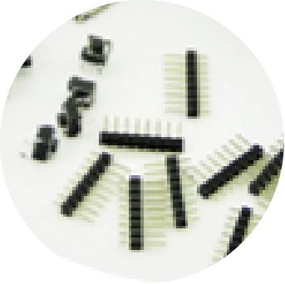
PCB Prototyping Capabilities
Electronic Services
01. PCB Prototyping
02.PCB Assembly
03.Flexible PCB
Easy to Use-upload Gerber file to get an instant quote.
1 to 50 pieces PCB assembly service with OPL components.
Customized flexible PCB from 1 layer to 2 layers.
04.Premium PCB
05.PCB Stencil
06.Electronic Badge
Customized PCB Prototyping-accommodate special requests(e.g., colors)
Customized SMT stencil for your design.
We layout, fabricate, and pack badges with components.
07.Changeable Cable
08. OPL
09.Fusion Gallery
Customize cables to satisfy special requirements.
Increase development efficiency with open source EDA library, 3-D modules, and datasheets.
Share your projects to allow everyone to use, modify and upgrade. Find other makers just like you!
01. 3D Printing
Rapid prototyping service with professional support.
www.makerfabs.com

Slide 7
Prototype to Product
Makerfabs PCB Assembly Service
Schematic design, PCB layout, component selection, mechanical design, packaging design etc.
Design for Manufacturing review (BOM, Gerber, Mechanical, Testing & Manufacturability)
Test plan and Quality Control
Maker friendly supply chain
ENGINEERING
SAMPLE
INITIAL
PRODUCTION
TRIAL
SMALL
BATCH
PRODUCTION
SALES
&
DISTRIBUTION
CODESIGN
PROTOTYPING
MASS
PRODUCTION
FULFILLMENT
Fusion prototyping service, recommendation;
New Product Introduction
Agile, flexible and precise
Your turnkey solution for taking a prototype to production
Learn more www.makerfabs.com
Partnership Inquiry:
Project Inquiry:

Slide 8
Our Approach
Design from Manufacturing
Part 02

Slide 9
Why always delay?
POTENTIAL TICKING TIME BOMBS
DESIGN REVIEW
PURCHASING
MANUFACTURING
Unclear BOM
Inefficient/Impractical Test plan
Ignorance of process restraint
Design for Manufacturing
Long lead time component
Structural parts
Large overhead process
Improper quality communication
Yield due to design and DFM
Test plan revision
Manufacturing Process
Assembly
Abnormal handling
www.makerfabs.com

Slide 10
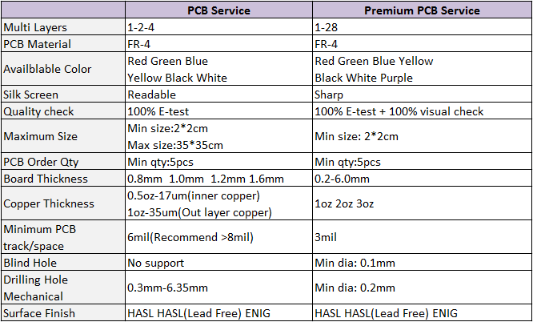
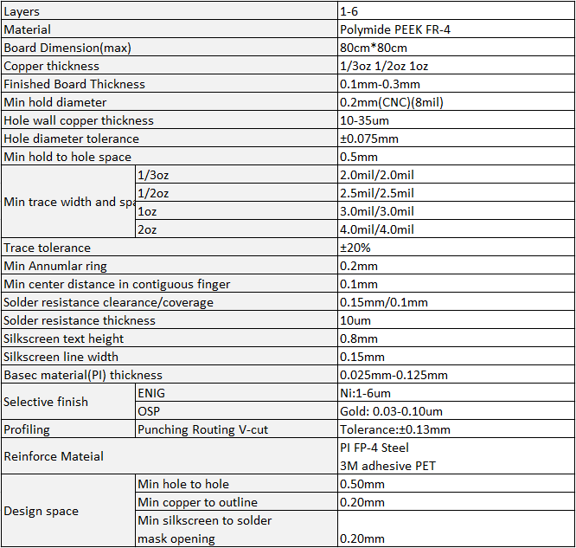
PCB Production
FR4:
FPC&Rigid-Flex:
For prototype: 100% functional Testing
For Mass Production: 100% zig Testing
https://www.makerfabs.com/Premium-PCB-Service.html
www.makerfabs.com

Slide 11
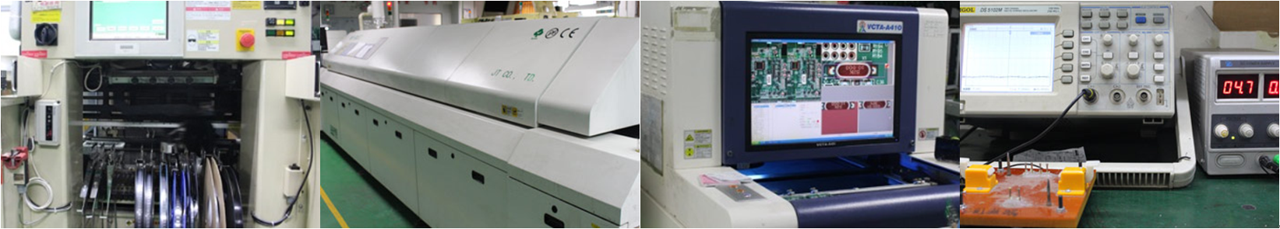
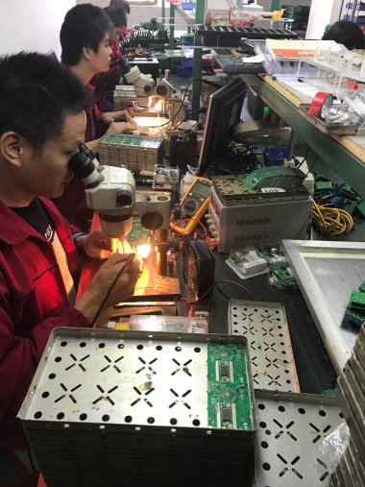
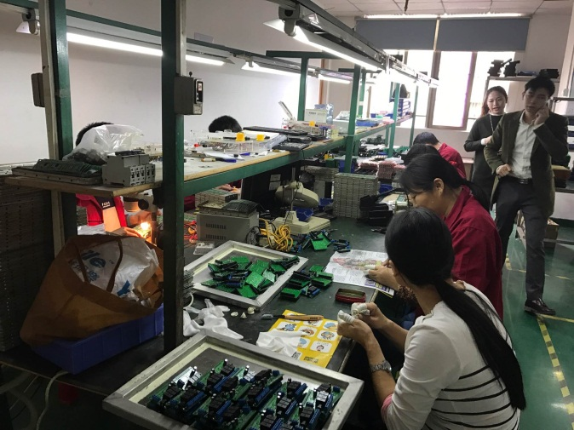
PCB Assembly
Pick-n-place machine
Reflow
Visual Checking
Engineering
+
100% functional Testing
Testing
THT Soldering&Cleanning
www.makerfabs.com

Slide 12
Our
Experience
Part 03

Slide 13
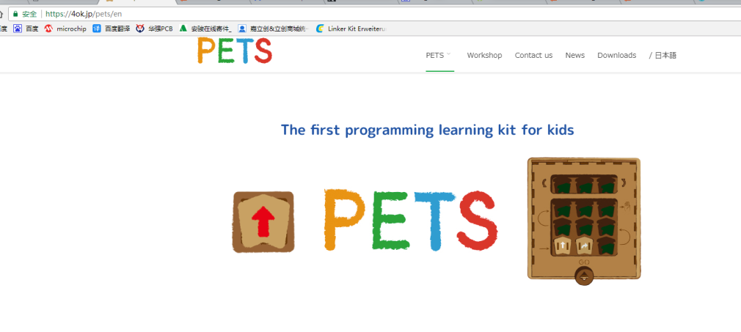
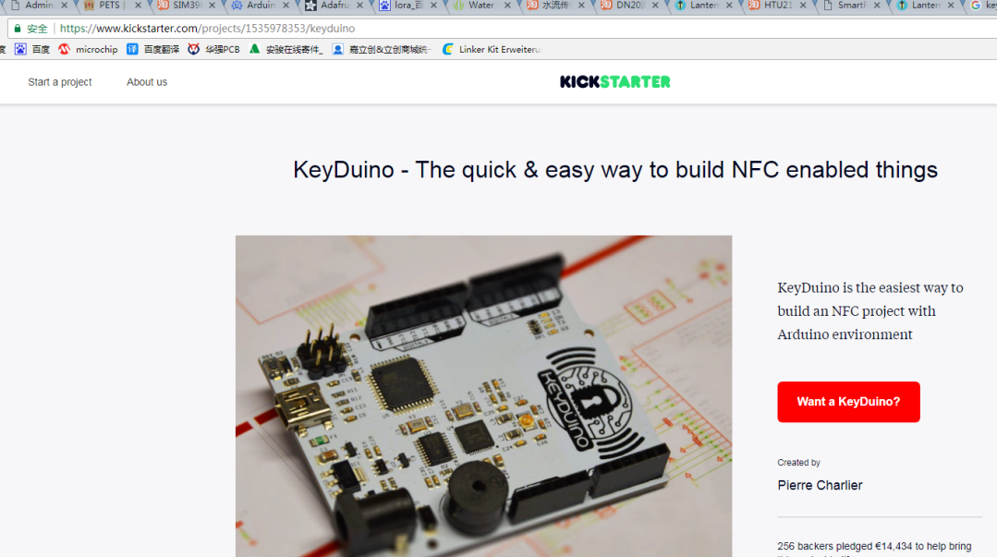
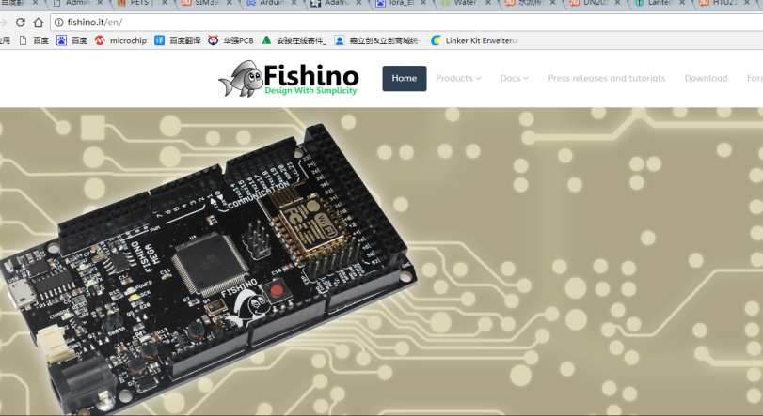
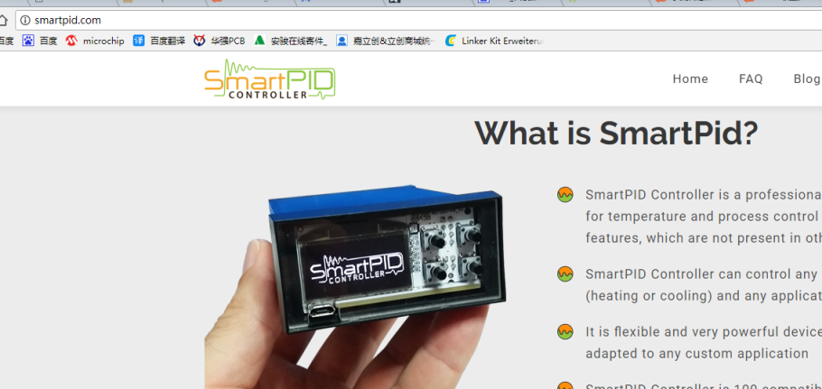
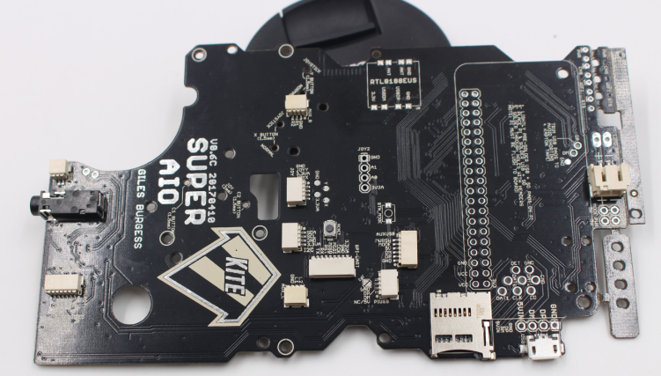

Slide 14

Thank You
Service@makerfabs.com

